Slide 1
Court Mediation in Finland, especially in Family Disputes
Judges’ experiences as mediators, Lviv, 18Dec2019
Marjo Naapi
Judge, Mediator

Slide 2
Summary of the presentation
Finnish Act on Court Mediation (663/2005)
Mediation in Family Disputes in District Courts
Experiences

Slide 3
Act on mediation in civil matters and confirmation of settlements in general courts
In force originally January 2006 (new act in May 2011, after the mediation directive 2008/52)
Applies to all civil matters (incl. family matters) in general courts
The objective of court mediation is an amicable resolution of the matter
Requires consent of all parties, both parents
Mediation may be commenced whether there is a matter pending in court or not; separate application/referral, joint request/by one party alone/judge’s initiative
The court decides on the commencement of mediation

Slide 4
A judge acts as a mediator (never in his/her own cases, the mediator shall not adjudicate in the same case)
There is also a possibility to ask for a certain judge to act as mediator in a specific case
Voluntary, facilitated, structured
The possibility to use an expert to assist in mediation (costs paid by the parties)
The settlement may be confirmed in court, and usually is

Slide 5
Mediation in Family Disputes
Based on the above mentioned Act on mediation...
Mediation should be carried out and the settlement confirmed so that the interests of the child are safeguarded and the provisions in the law concerning the custody of a child, visiting rights and the maintenance of a child are taken into account
A pilot project in some district courts from beginning of 2011, with the objective to increase settlements in cases where children are involved: co-mediation in courts, judge as a mediator and a psychologist or an experienced social worker as a co-mediator
A bill for permanent and nationwide proceedings got into force May 2014

Slide 6
Mediation as an alternative to a long and often strenuous trial
A special service that parents may use
Questions that may be brought up
Custody of the child
Living arrangements
Visiting rights
Maintenance of the child
Other matters concerning child’s everyday life that cannot be handled in a trial

Slide 7
The goal an amicable and a durable agreement in the best interest of the child
Mediation with expert assistance to ensure that questions that are essential with the regard to the best interests of the child are handled and the settlement reached is in the best interests of the child
Based on discussions with both parents present, or separately and possibly also with child
Always based on voluntariness

Slide 8
A judge acquainted with family matters acts as a mediator (never in his/her own cases, the mediator shall not adjudicate in the same case)
Always co-mediation with an expert in parenting and child development matters, a psychologist or an experienced social worker
Multi-professional team to support the parents in solving both the legal and the psychological problems
Voluntary, facilitated, structured
The agreement is confirmed in court by the mediator, valid similarly to a court decision and enforceable as such

Slide 9
Costs of the expert paid by the state (free of the parties)
No extra costs for using mediator (just court fee 250 euros, if not free legal aid)
Training of judges and experts to act as mediators, co-mediation, also cross scientifical training (child development, multicultural, parenthood etc.)

Slide 10
Experiences
More than 50 % of all family/child cases referred
Over 60 % of the cases are settled (more than 80 % of other civil cases)
In general families’ experiences are very good, feedback
Challenging, but judges commonly find it very rewarding
Very important is to distinct the roles, judge/mediator
Two equal experts working together
Facilities, calendars, preparation etc.
Tools; caucuses, temporary agreements, discussions with the child etc.

Slide 11
Experiences cont.
Judges acting as mediators for more than 10 years
Still acting as judges in other civil cases or as criminal judges in their courts, but not in the same cases
Confidentiality
Experience as mediators help judges in their work also as a judges (without mixing the roles)
Absolutely better for the families and especially for the children than the court proceedings
Also better for the courts, better for the social field; saving resources, shorter cycle of cases,

Slide 12
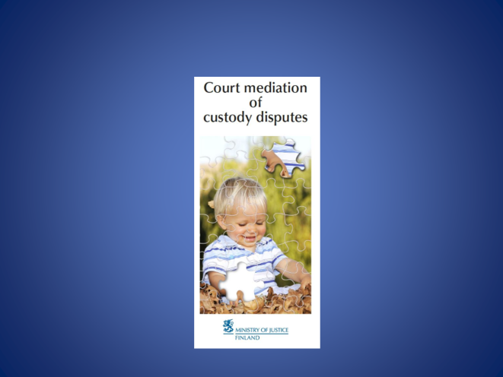

Slide 13
Thank you!
This presentation was produced with the financial support of the European Union. Its contents are the sole responsibility of PRAVO-JUSTICE and do not necessarily reflect the views of the European Union.

