Slide 1
E-court: Estonian experience Paavo randma supreme court of estonia

Slide 2
Where are we now?
no paper case files, except in criminal cases;
Court Information System (KIS) through various apps allows electronic communication with the parties;
judges can work remotely with digital case files;
judge can hold virtual court sessions.

Slide 3
ET
PRIS
KIS
MIS
AET
DT

Slide 4
PRIS
ÄR
MIS
RR
KIS
NAP
MKM KIS
ET
DT
KEIS
KIR
AET
KARR
VAET
JAAK
KÄPO
ERT
RIS

Slide 5
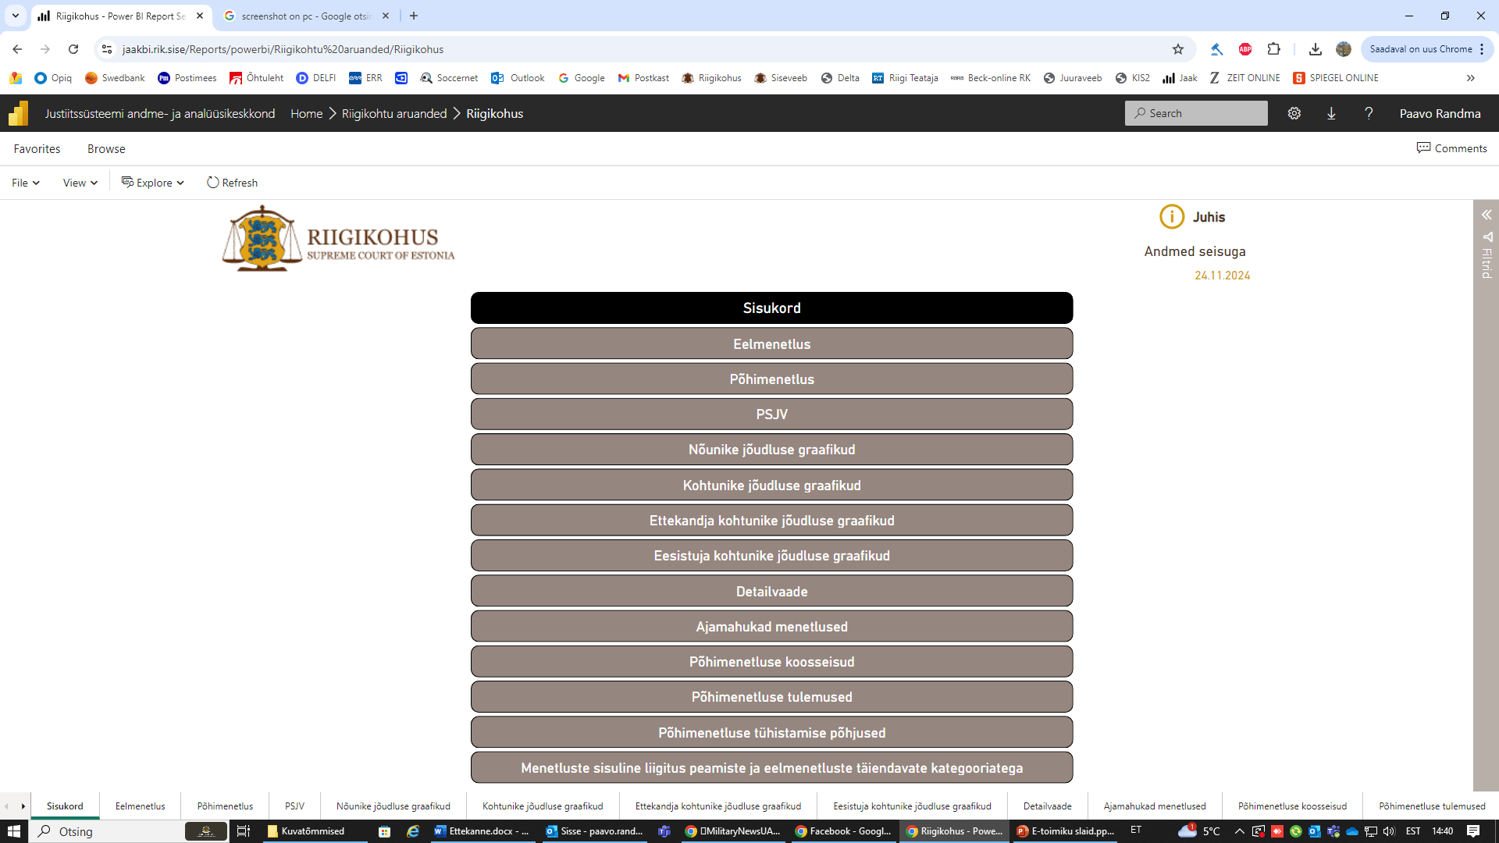

Slide 6
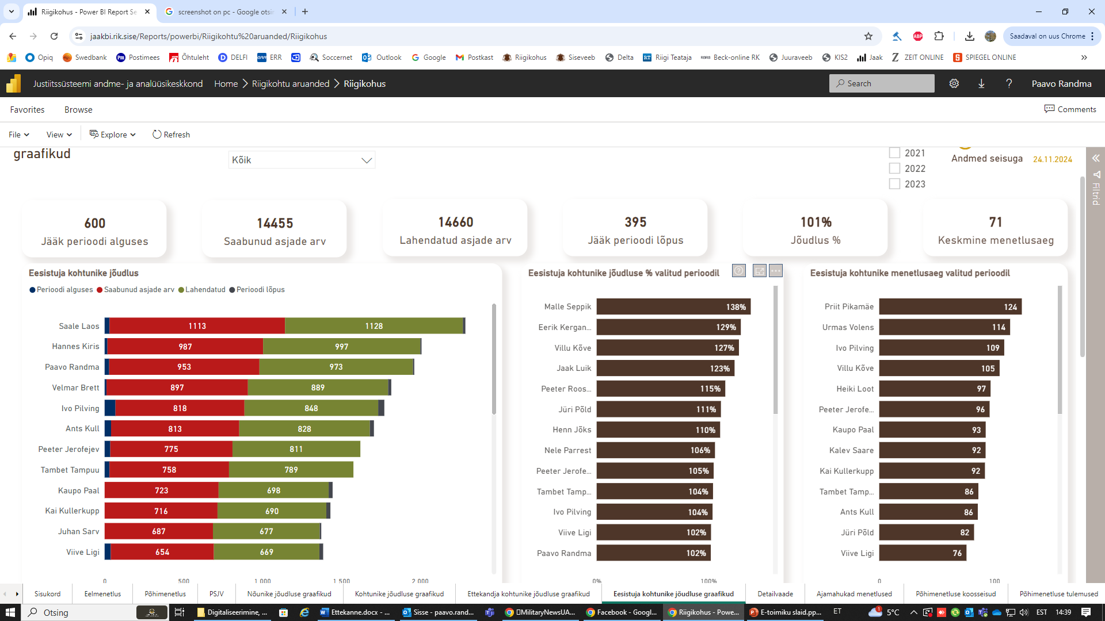

Slide 7
Problems with the existing information system
KIS is mirroring the paper file;
the system is document-based, not data-based;
working with a digital case file is time-consuming;
system failures due to data processing volumes;
too complicated and expensive to change and develope.

Slide 8
some questions raised
The courts are too easy to access?
Is it sometimes too convenient to participate in court proceedings?
A handy argument for the executive to change the way courts are organized
The independence of judges and its abuse

Slide 9
A new approach?
we can afford fewer people with the expectation that their qualification is even higher and they work more efficiently;
data volumes are increasing;
law is becoming more complex;
access to legal aid is low, there is a high number of unsatisfactory and unpromising court referrals.
CONCLUSION: We need a data-driven, intelligent system, that would partly take over the work of humans.

Slide 10
New court information system? (I)
KIS is built on the basis of data;
forms that could be easily filled in the information system;
AI will help with drafting actions and complaints;
KIS can generate basis for the judgements and other procedural documents;
digital signing is replaced by simpler approvals;
AI produces intelligent protocols;
AI produces translation and interpretation.

Slide 11
New court information system? (II)
AI can identify the person in remote hearings;
AI could take over interaction with people on their simple everyday requests;
AI distributes cases and unifies the workload;
AI could help to assess with the determination of costs and legal aid proceedings;
AI could be used in judgments for data cleansing

Slide 12
New court information system? (III)
AI takes partially over the pre-trial procedures and case management;
AI can analyse and summarise voluminous procedural documents, the parties’ arguments and evidence and draw conclusions from it;
AI can analyse law and case-law and also provide projects on how to settle the case on the basis of existing knowledge;
AI could help with out-of-court online platform-based dispute resolution.

Slide 13
Risks and challenges of implementing AI
we need robot assistants, not robot-judges. AI cannot take over judgements based on values or discretionary decisions,
too much trust in AI?
protecting personal data?

